Slide 1
Olympic Games
Elcy Timothy, Yealim Sung, Sijie Huang, Yu Hong, Hanying Shen
Notes:
Elcy

Slide 2

Background
Summer Olympics 2020!
The dataset consists of the modern Olympic Games information which is worth of 120 years from Athens 1896 to Rio 2016 on summer and winter Olympics.
Name, sex, age, height, weight, team, games, year, season, city, sport, event, and medal.
Notes:
Yealim
As the next summer Olympics is coming up soon, we wanted to predict various results such as the winner of the games, most medal-winning countries, and etc. The dataset consists of the modern Olympic Games information which is worth of 120 years from Athens 1896 to Rio 2016 on summer and winter Olympics.
By looking at the dataset and having so many potential visulization possibilities, it was difficult to come up with the questions.

Slide 3
Questions
What sports are the top 5 countries best at?
What countries have attended the Olympics the most and won the most medals from 1896 to 2016?
How height and weight change over time affect winning?
Comparing relationship between medal wins by sex
Notes:
Yealim
Firstly, we will be analyzing which sports are the top 5 Countries best at for the past 120 years. This can be done by using the data of Gold medals in sports that each country has the most of.
Secondly, we will see how is the attendance rate of each countries for the Olympic games and how did that affect the results.
Thirdly, we will see the athlete’s height and weight change over time and how that affects the results of the game. This will be done by analyzing the dataset of 120 years.
Lastly, we will see the progression of Women involved in Olympics over time, and the proportion of women on Olympic teams. This can also be done by analyzing the dataset of 120 years.

Slide 4
Cleaning the Data
Two datasets (271,116 X 15) (230X3)
Merge the two datasets into one
Drop the overlapping `Team` and `Country` by `NOC`(National Olympic Committee)
Check and locate all missing values
Clean the missing value in `Height` (60,171) and `Weight` (62,875)
Metal: 231,333 missing values -- > participated but did not win
Response variable: Medal
Explanatory variables: Sex, Height, Weight, Country, Attendance (New), and Sports
Notes:
Crystal:
Medal: Whether can win the medal or not / the number of medal wins
After dropping the all the missing values in Height and Weight, we checked if we still have the same number of medals for gold, silver, and bronze in the cleaned dataset, and it’s basically the same

Slide 5
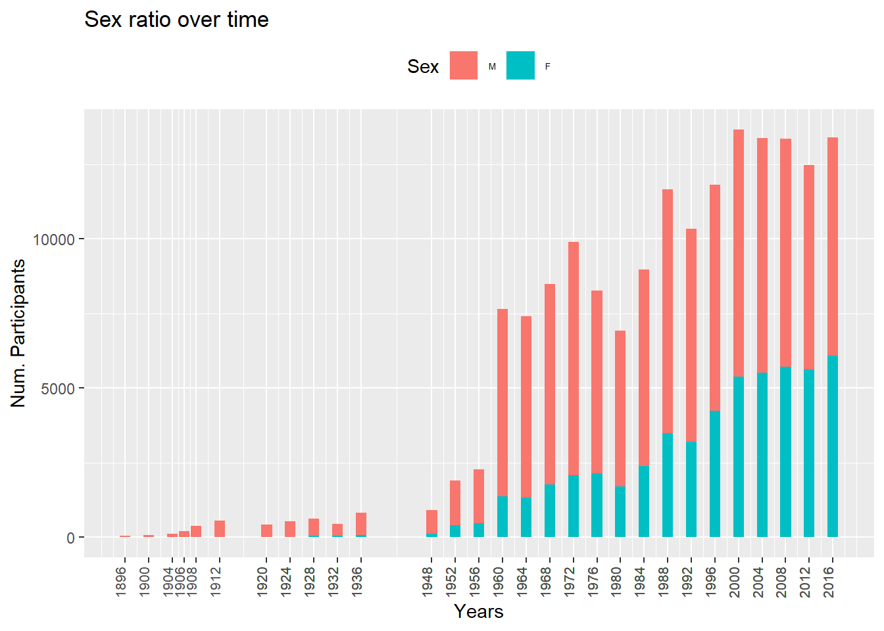
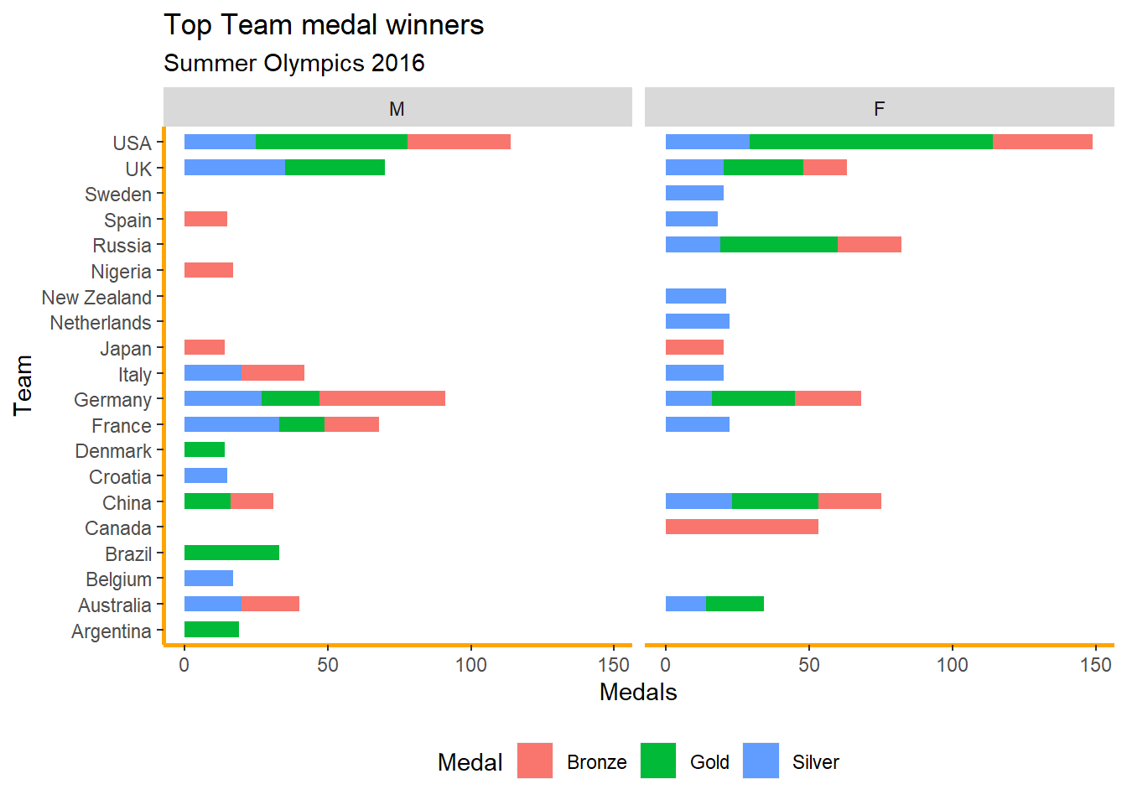
Comparing participation to medal wins by Sex
In this plot we see that the number of women involved in the Olympics was not significant until 1928.
This plot represents the number of medals that male and females won for Summer Olympics 2016.
Notes:
Elcy: Plot 1

Slide 6
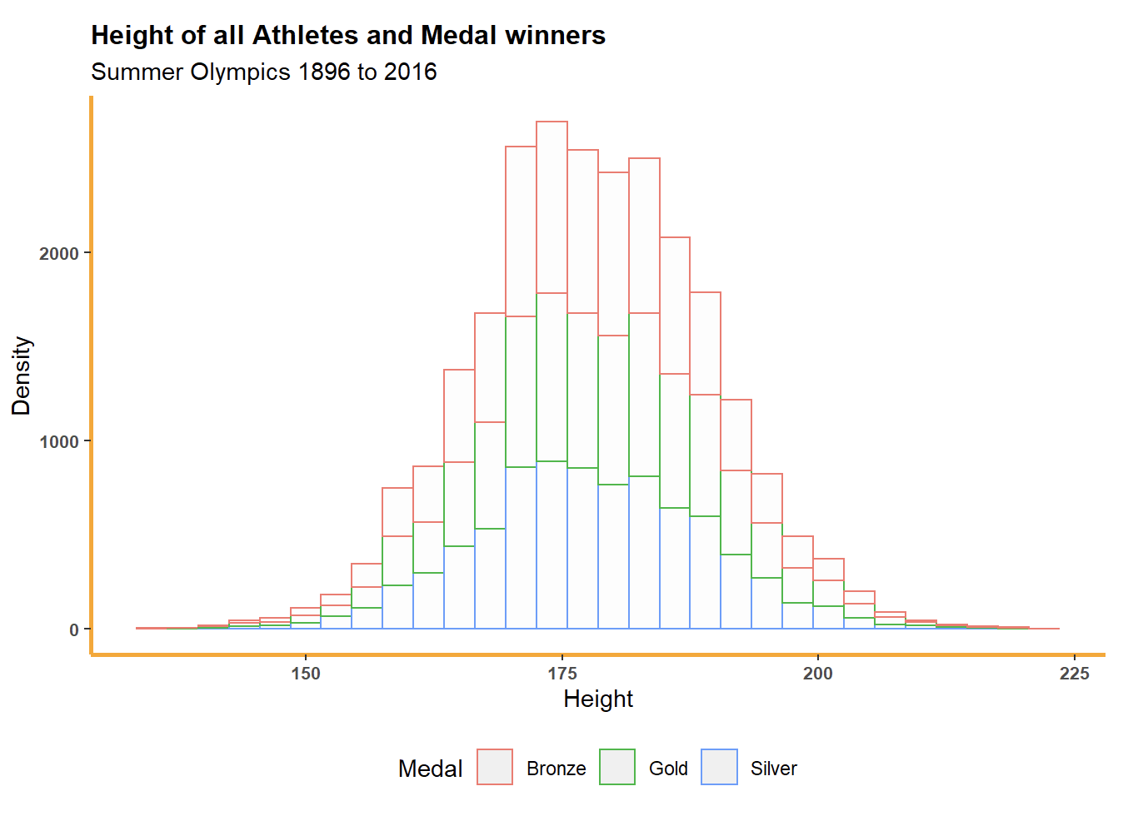
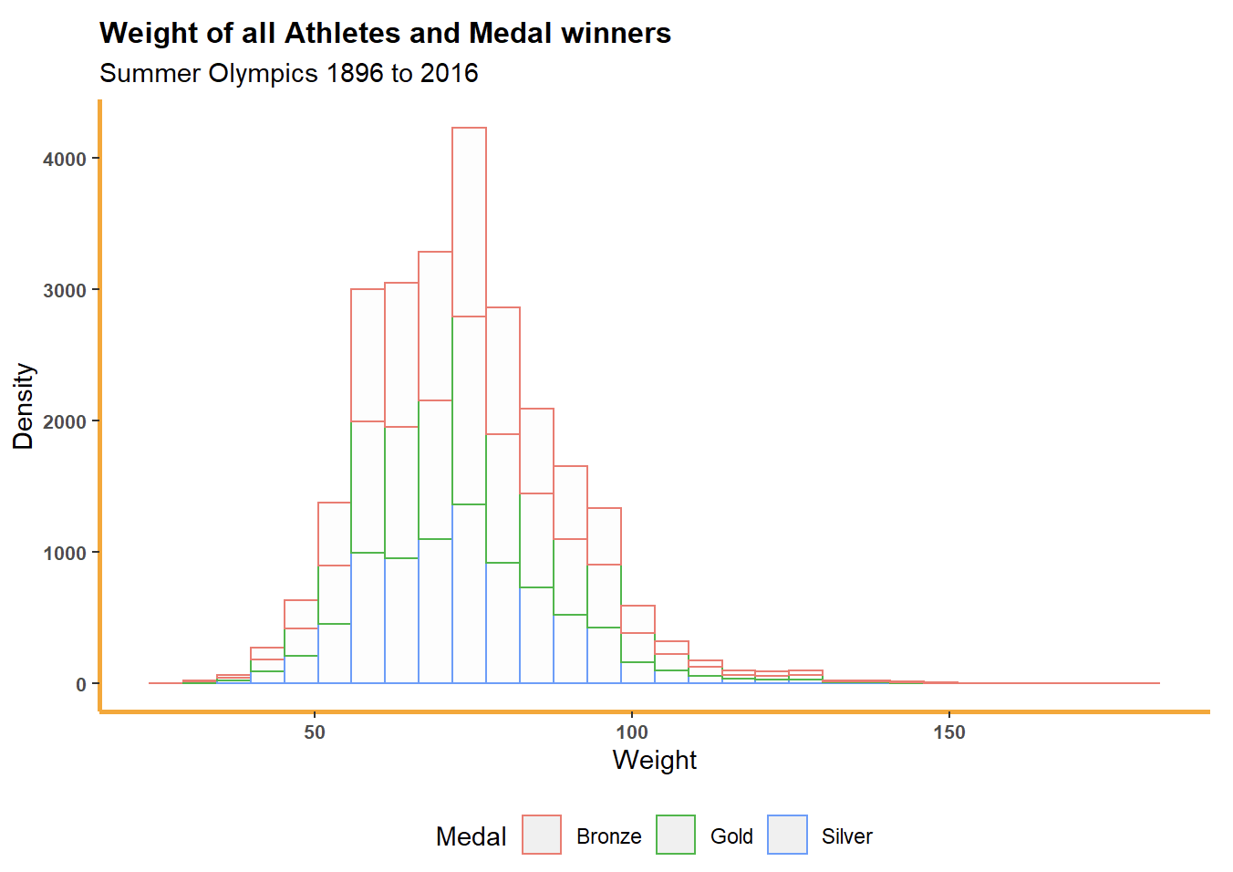
How height and weight change over time affect winning
No relation between the height/weight and the number of medals won
Notes:
Jessie:
The distribution of both plots are normal distributions with some outliers. The shape of the distribution of both height and weight is similar between people who have gold medal and silver ,bronze.
It shows the relationship between the number of each medal classes and weight/height. We excluded the missing values for medals in this plot. We can see there is no direct relationship showing that weight and height of the athletes will affect the result of the game. So we will take a look about other variables to find a possible relationship.

Slide 7
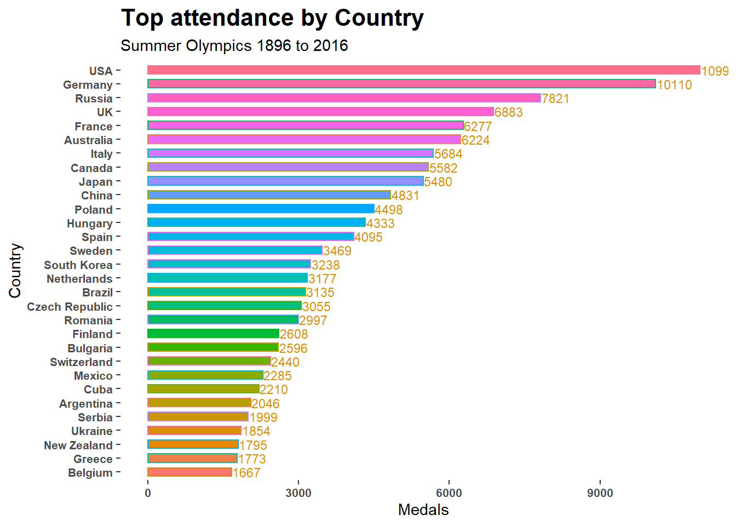
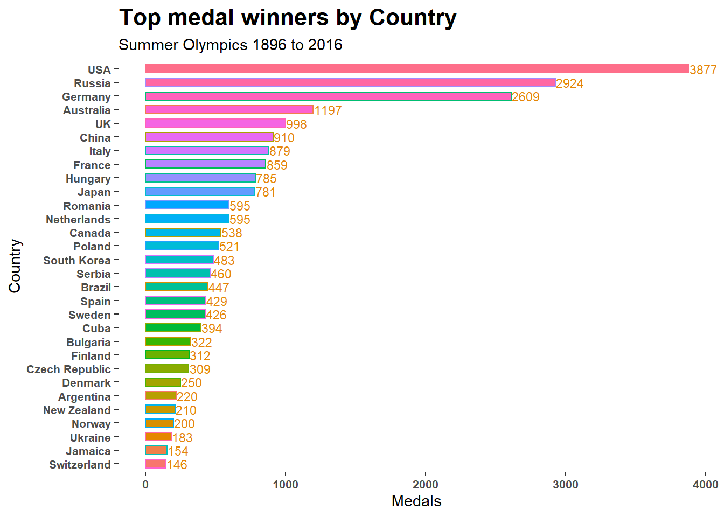
Relationship between attendance of games and medal wins
Notes:
Crystal:
We made a new column of Attendance, which counts the number of attendance of ALL sports for each country over years.
In these two plots, we showed the top 30 countries of their attendance of games and total medal wins by country. We can see that there are some overlapping countries for the tops ones in each plot, so we want to see if there is any relationship between the attendance of games and medal wins.

Slide 8
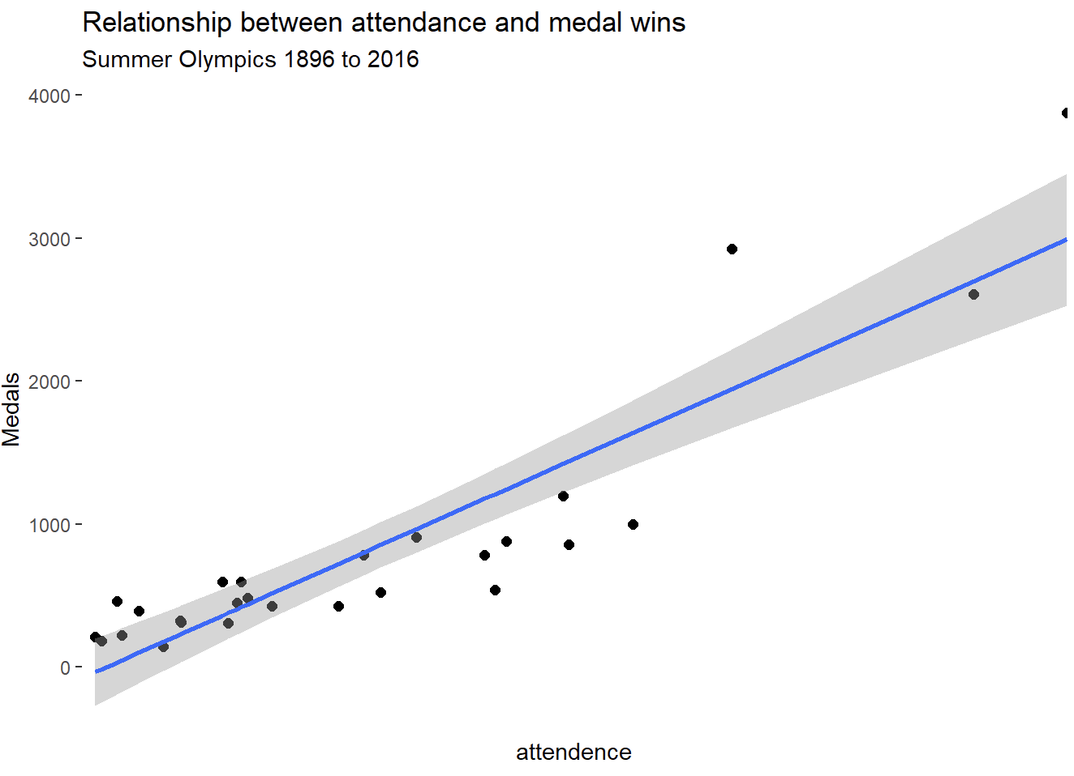
Relationship between attendance and medal wins
Positive
Strong correlated
Linear
If the Country attended the Olympic games the opportunity to win medal medals
Notes:
Crystal:
If the country participates more games in Olympics, they tend to have a bigger chance to win a medal.

Slide 9
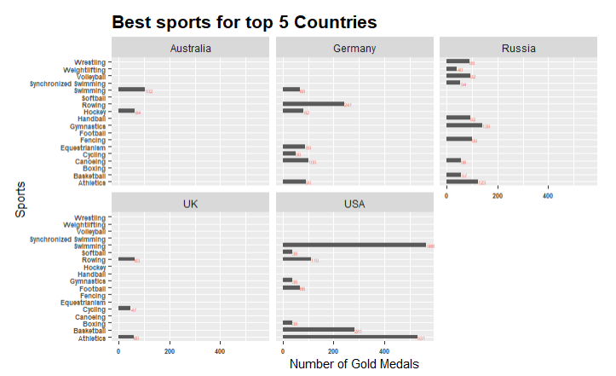
What sports are the top 5 countries best at?
Counted the number of Gold medals that each Country won throughout the years of 1896 to 2016 Summer.
Australia: Swimming
Germany: Rowing
Russia: Gymnastics
UK: Rowing
USA: Swimming
Notes:
Yealim
For this question, we counted the number of gold medals that each Country won throughout the years of 1896 to 2016 summer for each sports. By doing this, we can see which sports are the Countries best at. As you can see from the graph, Australia and USA are best at swimming, Germany and UK are best at Rowing, and Russia is best at Gymnastics.

Slide 10
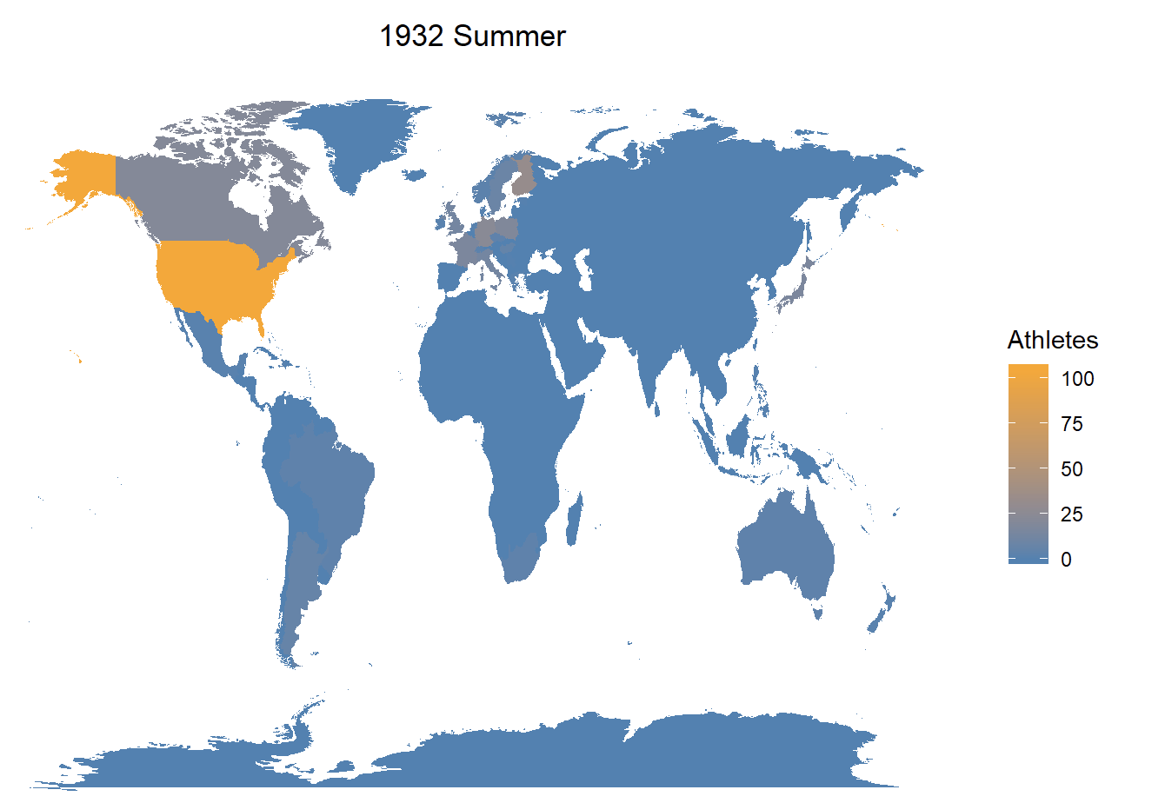
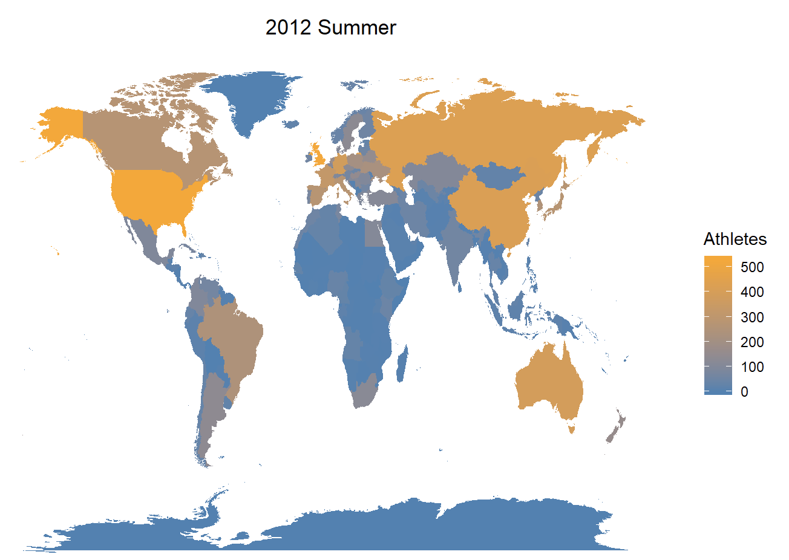
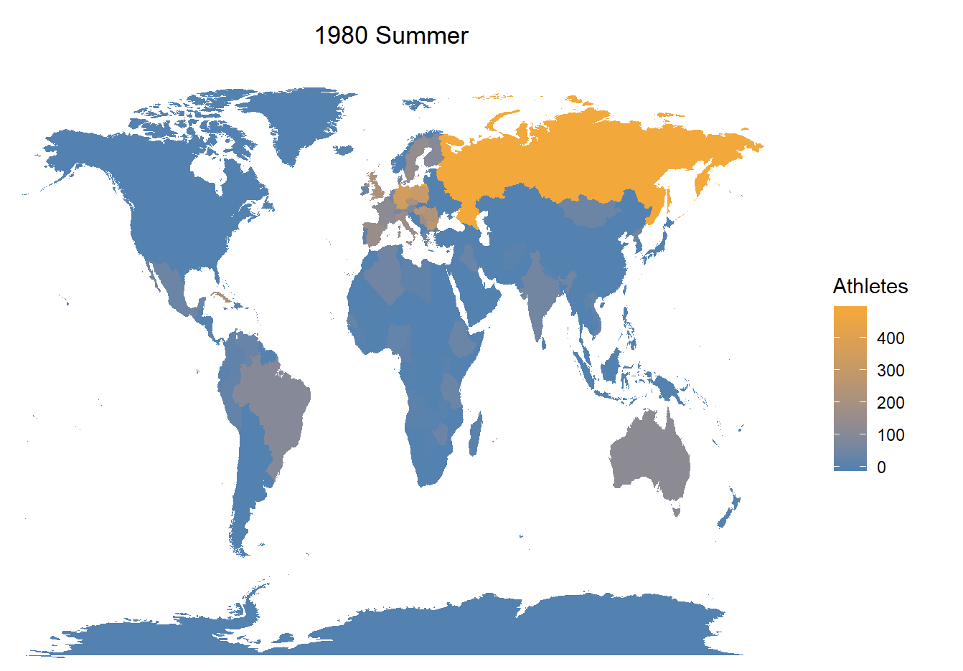
Attendance of Countries Through Years
More countries are participating in the Olympics over years.
Notes:
Yu:

Slide 11
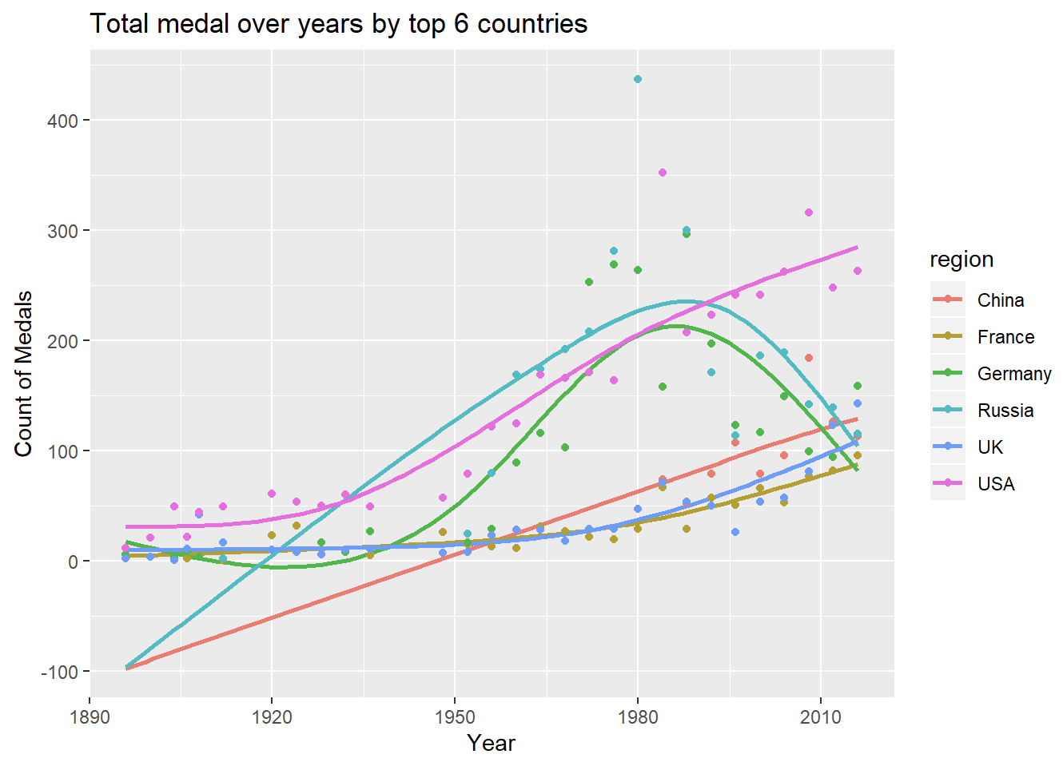
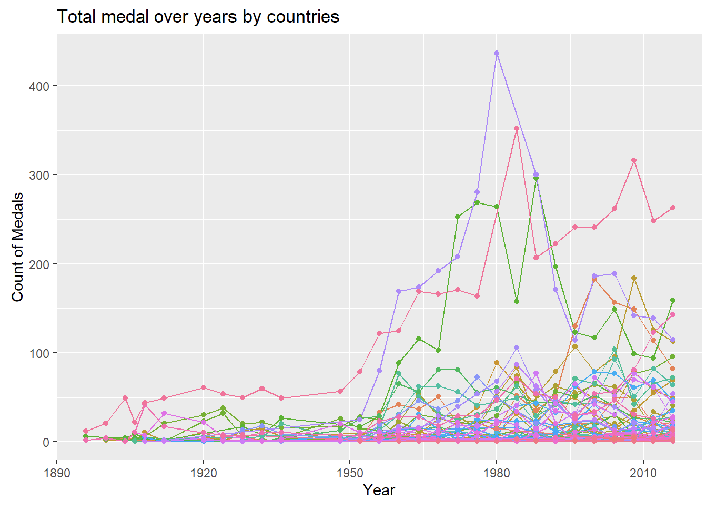
Total Medals over Years
Notes:
Yu:

Slide 12
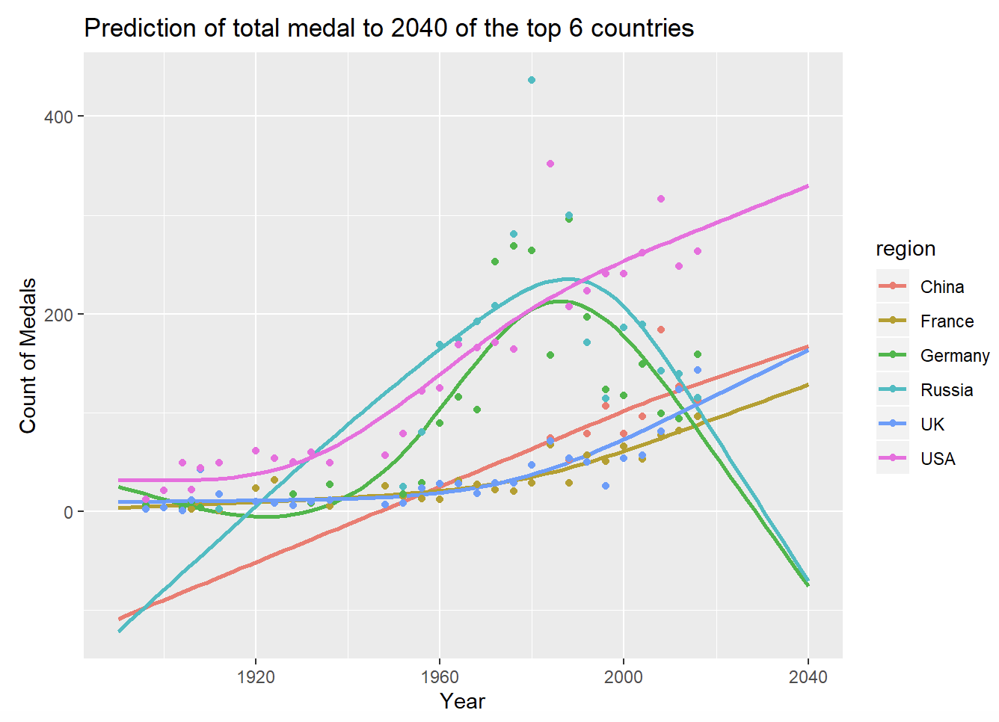
Prediction Modeling
Not appropriate to use this model
Impossible to be negative for Russia/Germany in 2040
Notes:
Yu

Slide 13
Challenges faced
The data is not predictable.
The variables are categorical variables which made it hard to model the data.
United States was dominating the Olympic games which made the prediction obvious.
Notes:
Jessie
The data is not predictable.Our response variable which is medal has 4 categories and the olympic final rank is not only depends on how many medal they get.
The variables are categorical variables which made it hard to model the data. For example,Country variable has more than 100 categories ,which is really hard to do process while we are doing the model
From the past data, we can see USA meals number has been far ahead,so it means USA was dominating the Olympic games which made the prediction obvious.

Slide 14
Conclusion
What sports are the top 5 countries best at?
Australia: Swimming
Germany: Rowing
Russia: Gymnastics
UK: Rowing
USA: Swimming
What countries have attended the Olympics the most and won the most medals from 1896 to 2016?
USA
How height and weight change over time affect winning?
It does not affect the winning results.
Comparing participation to medal wins by Sex
We can see that female participation in Olympics is increasing
Notes:
Elcy

Slide 15
Questions?

